Slide 1
Psychology and Personal Finance
Money and Happiness

Slide 2
Overview
What makes us happy?
Do we really know what makes us happy?
How to be happier
Money and Happiness

Slide 3
What Makes Us Happy?

Slide 4
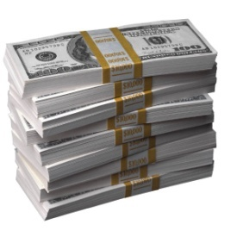
Do These Things Make Us Happy?
Wealth?

Slide 5
Income and Happiness
Sources: Layard (2005); Easterlin (2001)

Slide 6
Do These Things Make Us Happy?
😐
Wealth?
Marriage?

Slide 7
Marriage and Happiness
Sources: Kahneman et al (2004)

Slide 8
Do These Things Make Us Happy?
😐
😐
Wealth?
Youth?
Marriage?

Slide 9
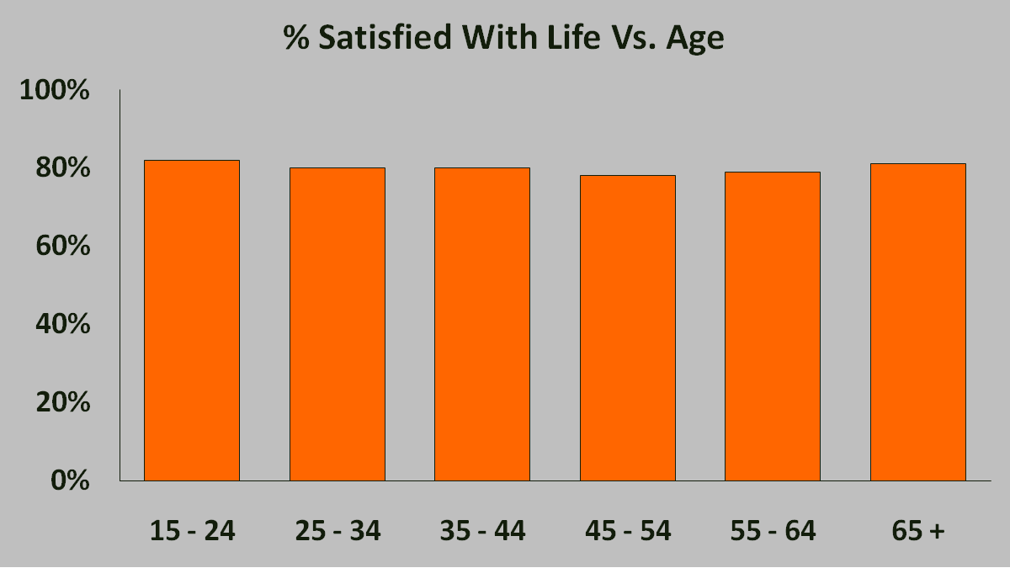
Youth and Happiness
Sources: Inglehart (1990)

Slide 10
Do These Things Make Us Happy?
😐
😐
😐
Wealth?
Youth?
Marriage?
Education?

Slide 11
Education and Happiness
There is no effect on happiness across countries and only a small effect within countries
Source: Helliwell (2003)

Slide 12
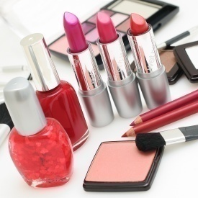
Do These Things Make Us Happy?
😐
😐
😐
😐
Wealth?
Youth?
Marriage?
Education?
Looks?

Slide 13
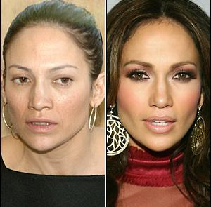
Looks and Happiness
Looks don’t make us happy after taking away the hair, makeup, jewelry and nice clothing
Source: Diener, et al (1995)

Slide 14
Do These Things Make Us Happy?
😐
😐
😐
😐
Wealth?
Youth?
Marriage?
Education?
☹
Looks?
Gender?

Slide 15
Gender and Happiness
Men are more prone to alcoholism, while women to depression
Source: Layard (2005)

Slide 16
Do These Things Make Us Happy?
😐
😐
😐
😐
Wealth?
Youth?
Marriage?
Education?
☹
☹
Looks?
Religion?
Gender?

Slide 17
Religion and Happiness
Religion does make us happy…but why?
Is it the “God” part which makes us happy, or the “community” part?
Sources: Seligman (2001); Putnam (2000); Layard (2005)

Slide 18
Do These Things Make Us Happy?
😐
😐
😐
😐
Wealth?
Youth?
Marriage?
Education?
☹
☺
☹
Looks?
Religion?
Gender?
Family?

Slide 19
Family and Happiness
People with the highest levels of happiness have strong social relationships
Sources: Seligman (2001); Putnam (2000); Layard (2005)

Slide 20
Do These Things Make Us Happy?
😐
😐
😐
😐
Wealth?
Youth?
Marriage?
Education?
☹
☺
☹
☺
Looks?
Religion?
Gender?
Family?

Slide 21
What We’ve Learned (So Far)
What makes us happy?

Slide 22
Do We Really Know What Makes Us Happy?

Slide 23
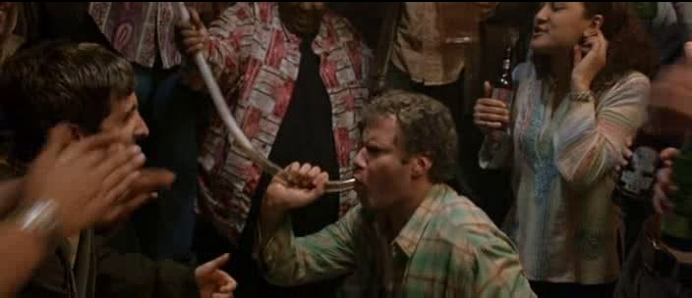
Are These People Happy?

Slide 24
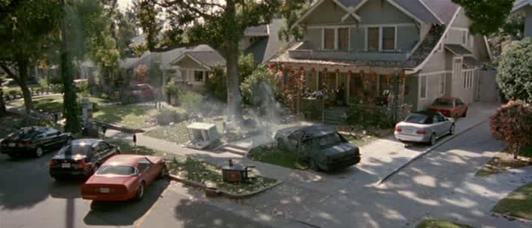
What About Now?

Slide 25
Long Term vs. Short Term Happiness
“In the moment” and “Morning after” have very different levels of happiness
Momentary happiness and life satisfaction could be dramatically different too
Obese people love to eat the food they do…but are not happy with their overall life
Sources: Kahneman et al (2004), Kahneman et al (2006)

Slide 26
The Focusing Illusion
We fail to recognize that people do not continuously think about their circumstances, whether positive or negative
As a result, we tend to exaggerate the effect of various circumstances on well-being
Paraplegics are not as miserable as you think and lottery winners are not as happy as you think
Sources: Kahneman et al (2004); Kahneman et al (2006)

Slide 27
The Focusing Illusion
Would you be happier than these people if you won the lottery?

Slide 28
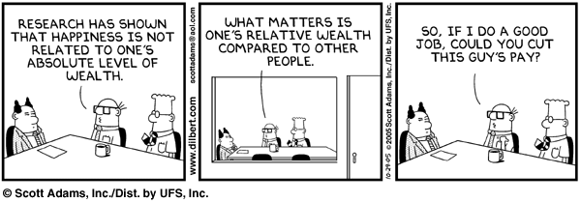
Is It Relative Income That Matters?

Slide 29
What We’ve Learned (So Far)
What makes us happy?
Do we really know what makes us happy?
Life satisfaction vs. experienced happiness
The focusing illusion
Relative income

Slide 30
How To Be Happier

Slide 31
Can We Increase Our Happiness?
The Nature View:
Happiness is like height: We are born with it
Twins: 50% Genetic, 8% Circumstantial (income, education, etc.)
The Nurture View:
Although people are genetically different, we can consistently affect our happiness levels
42% is a lot left unexplained – can we do something about it?
Source: Lykken (1996)

Slide 32
Trick # 1 – How to Spend Your Time
Source: Kahneman et al (2004)

Slide 33
Trick #2 – Positive Psychology
Positive psychology identifies 3 distinct routes to “happiness”
Positive emotion and pleasure
Engagement
Meaning
Sources: Seligman (2002); Peterson et al (2005)

Slide 34
Specific Tricks That Work
Gratitude visit
Write and deliver a letter of gratitude to someone who had been kind but never properly thanked
Three good things in life
Write down 3 things that went well every night for 1 week and provide a causal explanation for each good thing
Using signature strengths in a new way
Use 1 of top 5 “signature” strengths in a new and different way daily for 1 week
Source: Seligman et al (2005)

Slide 35
What We’ve Learned (So Far)
What makes us happy?
Do we know what makes us happy?
How to be happier
How to spend your time
Positive psychology

Slide 36
Money And Happiness

Slide 37
Economist Advice
More is Better!

Slide 38
Economics vs. Hedonomics
One analogy
A person that loves wooden blocks becomes bored playing with the ones he has had for a while
How can we make him happier?
A solution from Economics: Acquire more blocks!
A solution from Hedonomics: Learn to combine the blocks in new and more satisfying ways!
Source: Hsee et al (2007)

Slide 39
Examples of Hedonomics at Work
Changing reference points can change the hedonic experience:
Don’t compare yourself to your MBA classmates…but your high school classmates
Reference point can be real or counterfactual:
Are Olympic bronze medalists happier than silver medalists?
Source: Medvec et al (1995)

Slide 40
Hedonic Arbitrage
Increasing investors / consumers’ hedonic experience without necessarily increasing their income, wealth, or spending

Slide 41
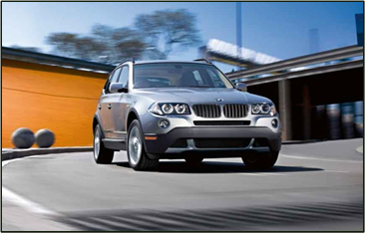
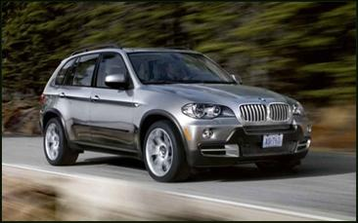
Trick # 1 – Consider Opportunity Costs
BMW X3 and
Free Gas for 3 Years
BMW X5
$46,200
$46,200
41

Slide 42
Trick # 2 – Create Multiple Accounts
Nest-egg account managed by professionals and kept largely out of sight
Have fun account managed by investor with low transactions costs and lots of feedback (although perhaps with limits on leverage and non-zero liability investments)

Slide 43
Potential Benefits of These Accounts
Investors get to have fun (and possibly make some money)
At the same time, they are protected from the downside of the natural desire to meddle

Slide 44
What We’ve Learned
What makes us happy?
Do we really know what makes us happy?
Life satisfaction vs. experienced happiness
The focusing illusion
Relative income
How to be happier
How to spend your time
Positive psychology
Money and happiness
Hedonomics
Hedonic Arbitrage

Slide 45
Class Exercise
Create a business model to make money by promoting happiness

Slide 46
Class Discussion
Should the government consider
implementing policy to promote
happiness as well as wealth?

