Slide 1
Psychology and Personal Finance
Sub Optimal Spending

Slide 2
First – A Question:
How much could you reduce your spending (being smarter about your purchases) without depriving yourself or limiting your happiness?

Slide 3
Overview
Sub Optimal Spending
Heuristics Used in Spending Decisions
How to Help People Make Better Financial Decisions

Slide 4
Sub Optimal Spending

Slide 5
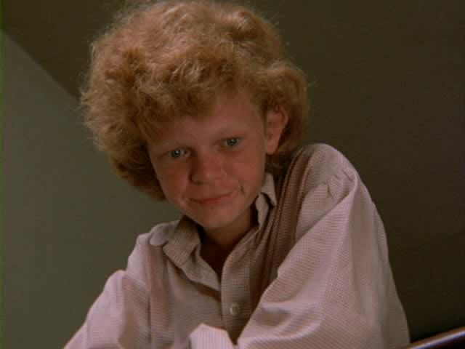
Tom Sawyer Trick

Slide 6
What We’ve Learned (So Far)
Sub Optimal Spending
  People do not know what they like or dislike

Slide 7
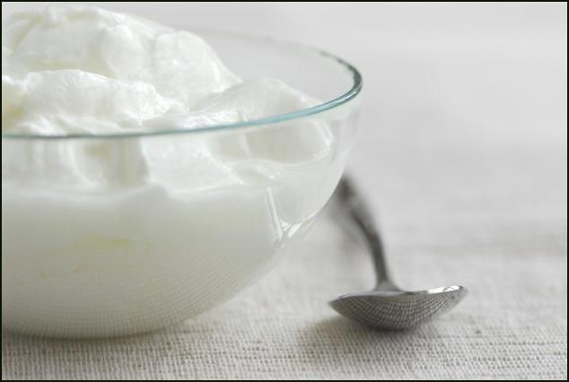
The Yogurt Experiment
Subjects tasted a spoonful of plain yogurt, then immediately rated the experience
They then predicted their rating for finishing a whole cup of the yogurt
Source: Kahneman and Snell, (1992)

Slide 8
The Yogurt Experiment Results
Most predicted the taste and the full portion would be as enjoyable
They did not consider that eating a much larger portion is different from a spoonful
Even when people know what they like, they might not know what they will like
Source: Kahneman and Snell, (1992)

Slide 9
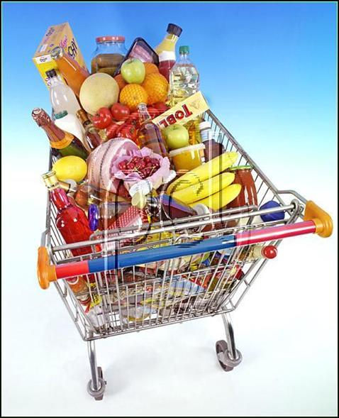
“Never Shop on an Empty Stomach”
There is a positive correlation between over-shopping and hunger
Projection Bias: people wrongly believe that current preferences indicate future preferences
Source: Loewenstein, et. al (2000)

Slide 10
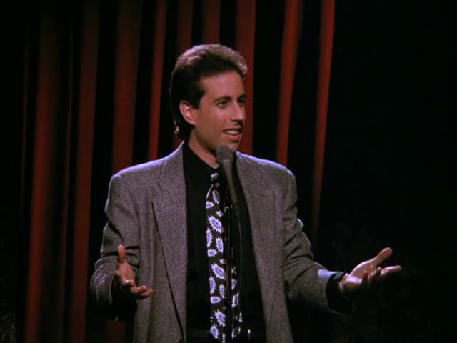
Projection Bias

Slide 11
What We’ve Learned (So Far)
Sub Optimal Spending
  People do not know what they like or dislike
  People do not know what they will like and dislike
    Projection Bias

Slide 12
Attention Wine Connoisseurs…
Subjects shown an average bottle of wine, then asked if they would pay an amount equal to the last two digits of their Social Security Number
Results: Those with the highest SSN
would pay three times more than those
with lowest SSN
Source: Ariely et al (2003)
Notes:
Our experiments take an old trick from the experimental psychologists’ arsenal—the anchoring manipulation—and use it
to inuence valuation of products and hedonic experiences with normatively irrelevant factors. In a famous early demonstration
of anchoring, Tversky and Kahneman [1974] spun a wheel of fortune with numbers that ranged from 0 to 100, asked subjects
whether the number of African nations in the United Nations was greater than or less than that number, and then instructed subjects
to estimate the actual .gure. Estimates were signi.cantly related to the number spun on the wheel (the “anchor”), even
though subjects could clearly see that the number had been generated by a purely chance process.2 This, and many other
anchoring studies seemed to show that people lack preexisting subjective probability distributions over unknown quantities.

Slide 13
Willingness To Pay For A Bottle Of Wine
Source: Ariely et al (2003)

Slide 14
WTP for a “Rare” Bottle of Wine
Source: Ariely et al (2003)

Slide 15
Coherent Arbitrariness
Suppose a subject with a SSN ending in 25 has a WTP of
  $5 - $30 for an “average” bottle
  $10 - $50 for a “rare” bottle
If the subject’s WTP is $25 for average, then the WTP for the rare bottle should be more than $25
Source: Ariely et al (2003)

Slide 16
What We’ve Learned (So Far)
Sub Optimal Spending
  People do not know what they like (or will like)
  People do not know how much to pay
    Coherent Arbitrariness

Slide 17
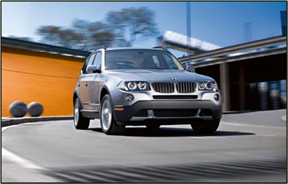
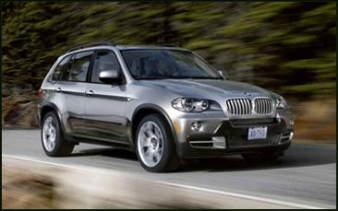
Question: Which Would You Choose?
BMW X3
BMW X5
$38,000
$46,200
17

Slide 18
Opportunity Costs
If you are like most consumers, you’d pick the BMW X5
Is an additional $8,200 worth it?
Did you consider the opportunity costs?
18

Slide 19
Question (Revisited): Which Option?
BMW X3 and
Free Gas for 3 Years
BMW X5
$46,200
$46,200
19

Slide 20
What We’ve Learned (So Far)
Sub Optimal Spending
  People do not know what they like (or will like)
  People do not know how much to pay
    Coherent Arbitrariness
    Ignoring opportunity costs

Slide 21
Time For A Survey
Answer the following survey questions
and keep score on your paper.

Slide 22
Question 1
Which of the following descriptions fits you best?
2 3 4 5 6 7 8 9 10 11
Difficulty Spending Money
About
the
Same
Difficulty Controlling
Spending
Source: Loewenstein, et al (2007)
22

Slide 23
Survey
Some people have trouble limiting their spending: they often spend money on meals, clothing, etc. when they would do better not to.
Other people have trouble spending money, perhaps because it makes them anxious. They often don’t spend money on things they should.
Source: Loewenstein, et al (2007)

Slide 24
Question 2
(a) Do you have trouble limiting your spending?
1 2 3 4 5
(b) Do you have trouble spending money?
5 4 3 2 1
Never
Rarely
Sometimes
Often
Always
Never
Rarely
Sometimes
Often
Always
Source: Loewenstein, et al (2007)

Slide 25
Survey
Mr. A is accompanying a friend who is on a shopping spree at the mall. Mr. A sees that the department store has a “one-day-only” sale where everything is 10-60% off. He realizes he doesn’t need anything but ends up spending almost $100 on stuff.
Source: Loewenstein, et al (2007)

Slide 26
Survey
Mr. B is accompanying a friend who is on a shopping spree at the mall. Mr. B sees that the department store has a “one-day-only” sale where everything is 10-60% off. He figures he can get great deals on many items he needs, yet the thought of spending the money keeps him from buying the stuff.
Source: Loewenstein, et al (2007)

Slide 27
Question 3
In terms of your own behavior, are you more similar to Mr. A or Mr. B?
1 2 3 4 5
Mr. B
Same / Neither
Mr. A
Source: Loewenstein, et al (2007)

Slide 28

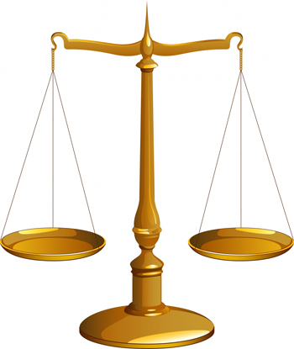
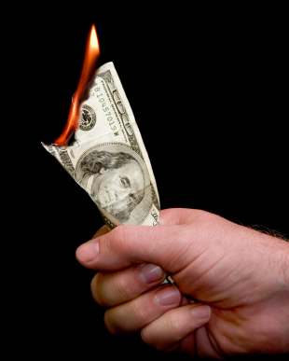
Now, Add Up Your Score
4 – 11 =
Tightwad
12 - 18 =
Unconflicted
19 – 26 =
Spendthrift

Slide 29
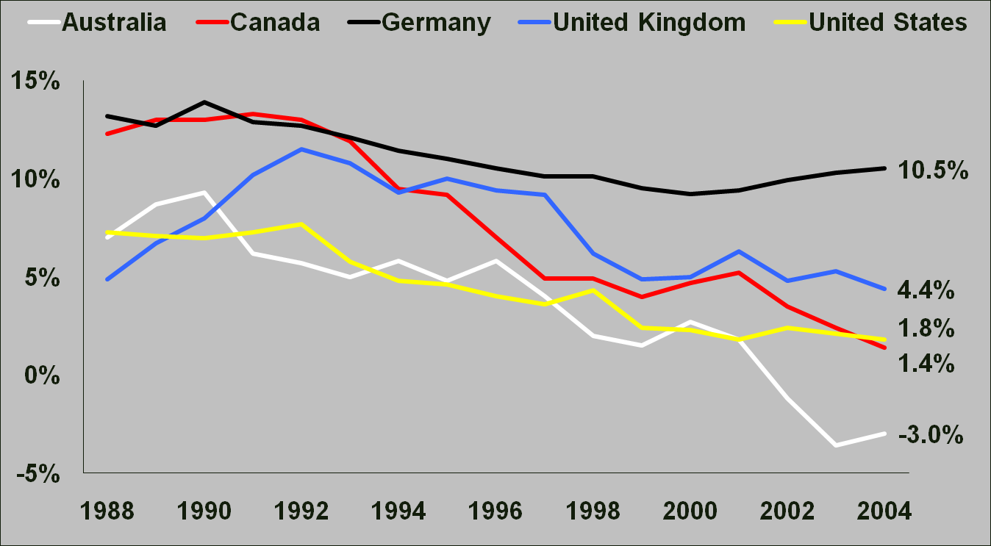
Low Household Saving Rates
Source: OECD 2006

Slide 30
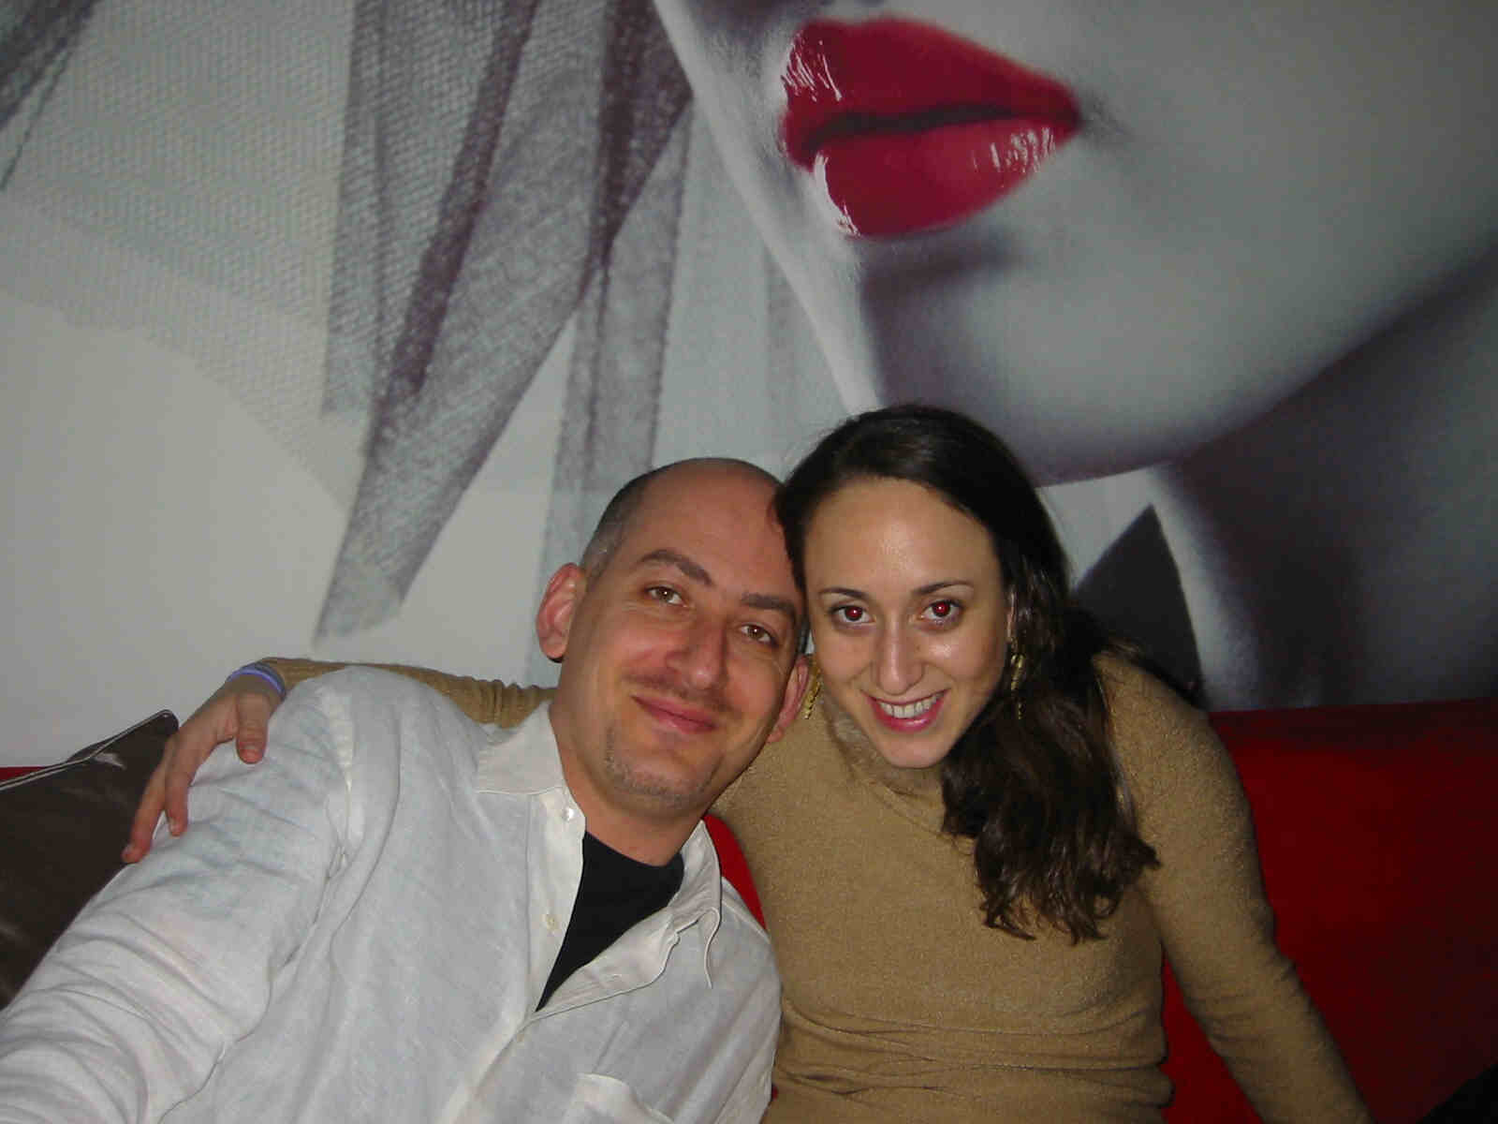
Shlomi and Lesli Migrate to China

Slide 31
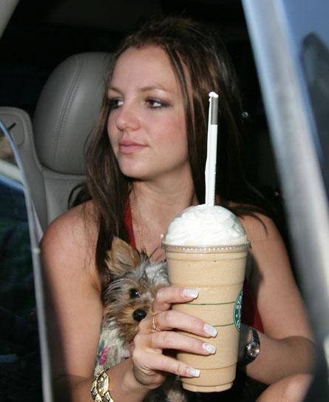
People Spend Too Much
In China, some men were spending 40% of their income on Starbucks coffee…
…just to look cool!

Slide 32
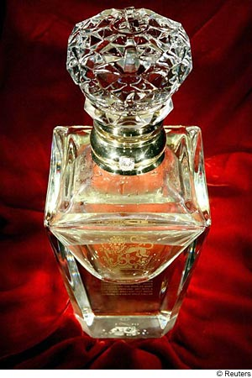
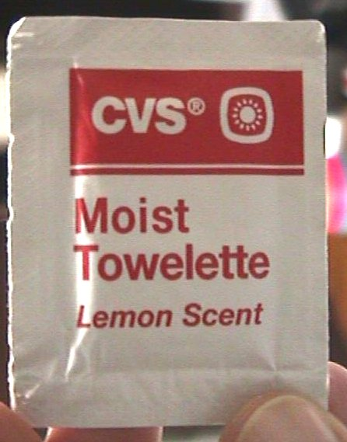
People Spend Too Much
In China, some women were spending 50% of their income on imported perfumes…
… which they couldn’t distinguish from wet towels!
?

Slide 33
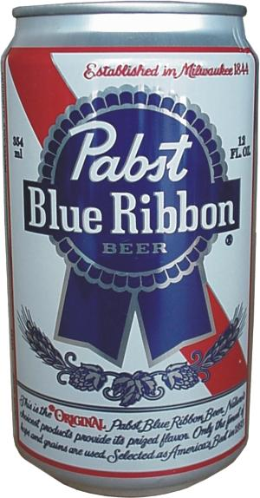
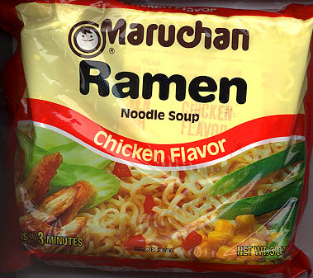
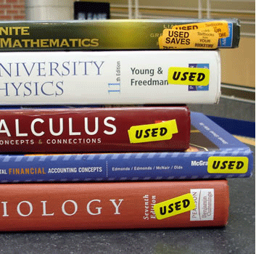
Do MBAs Spend Too Little?
33
Notes:
33

Slide 34
Permanent Income Hypothesis
Consumption should be dictated by long-term income expectations, not just current income
MBA students, and others who expect a prosperous future, should borrow and enjoy themselves today ☺
Source: Friedman, (1957)
34

Slide 35
What We’ve Learned (So Far)
Sub Optimal Spending
  People do not know what they like (or will like)
  People do not know how much to pay
  People spend too much (though some spend too little)

Slide 36
Borrowing Too Much
Average of 13 credit cards per household in 2005
Average of $8,200 credit card debt per household in 2008
Average of 14.3% interest rate on reward credit cards in 2008
Source: www.indexcreditcards.com, http://www.harpers.org/archive/2005/12/0080830

Slide 37
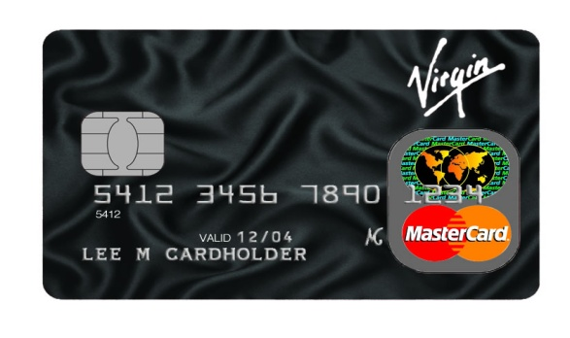
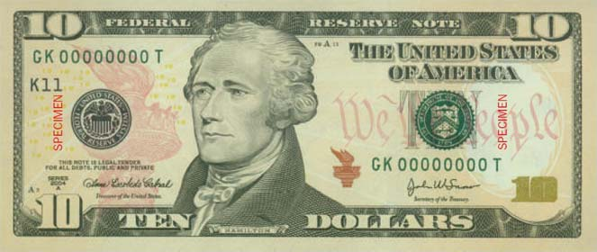
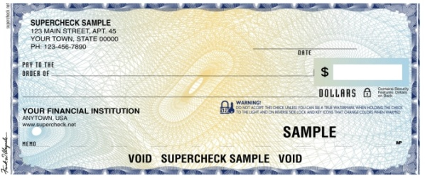
Purchasing Behavior
CASH | CHECK | CREDIT CARD
High Transparency | Medium Transparency | Low Transparency
Can see how much you are spending outright | Have to write out the amount on a check | Don’t see money changing hands
Source: Soman, (2003)
37

Slide 38
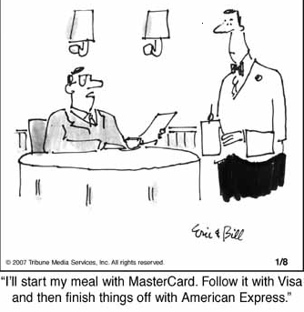
Credit Card Spending
People tend to tip more if they are putting it on a credit card versus giving cash
Source: Feinberg, (1986)
38

Slide 39
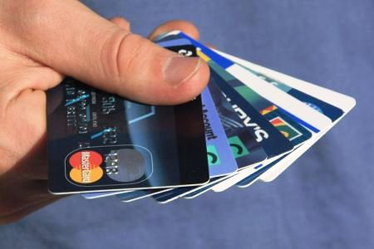
Credit Card Spending
People who own more credit cards make larger purchases per department store visit
Source: Hirschman (1979)
39

Slide 40
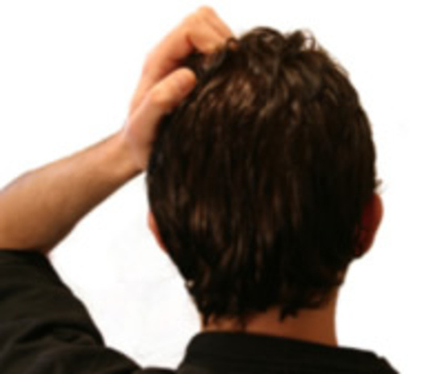
Credit Card Spending
Credit card users are more likely to underestimate or forget the amount of recent purchases
Source: Soman (1999)
40

Slide 41
The Power of Credit Cards
If credit card ads are visible (even though they’re not mentioned and supposedly unrelated to the experiment) subjects give a higher willingness-to-pay estimate for an item
Source: Feinberg, (1986)
41

Slide 42
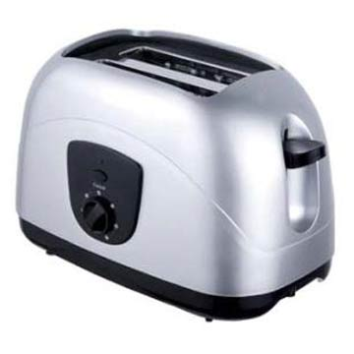
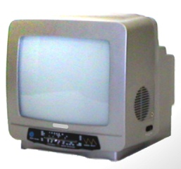
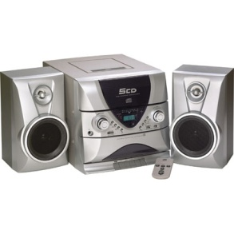
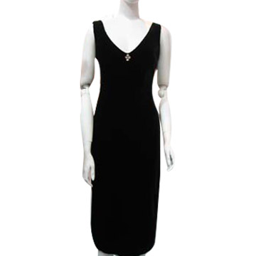

Price Estimates from Experiment
NO VISIBLE CREDIT CARD AD | VISIBLE CREDIT CARD AD
$21.50 $67.33
$67.00 $136.92
$157.42 $191.17
$25.42 $49.42
$33.42 $67.33
Source: Feinberg, (1986)
42

Slide 43
What We’ve Learned (So Far)
Sub Optimal Spending
  People do not know what they like (or will like)
  People do not know how much to pay
  People spend too much and borrow too much

Slide 44
Heuristics Used in
Spending Decisions

Slide 45
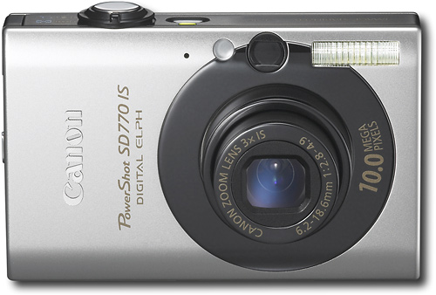
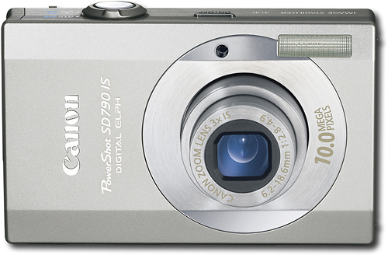
Extremeness Aversion
When two options with similar
attributes are presented …
$250
$300
… people pick the less expensive option

Slide 46

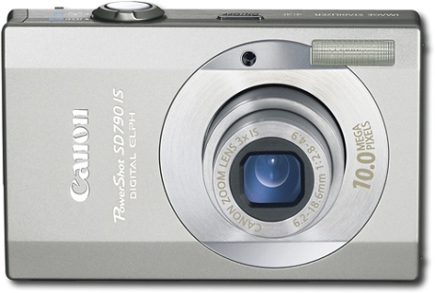
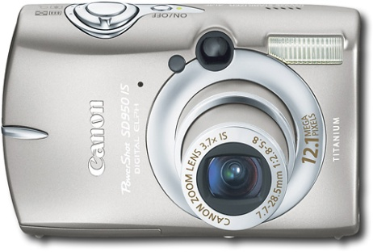
Extremeness Aversion
When a more expensive third
option is available …
$250
$300
$400
… people tend to go for the middle of the road

Slide 47
What We’ve Learned (So Far)
Sub Optimal Spending
  People do not know what they like (or will like)
  People do not know how much to pay
  People spend too much and borrow too much
Heuristics Used in Spending Decisions
  Extremeness Aversion

Slide 48
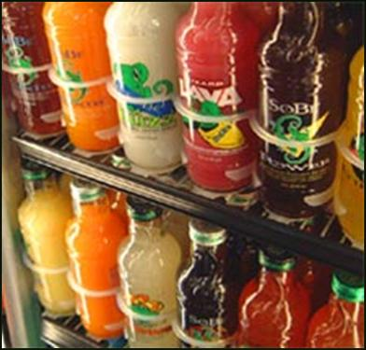
An Experiment: Buying SoBe Drinks
One group purchased at the regular price
Another group purchased at a discounted price
There were all given the same test - to complete as many of 15 total puzzles as possible in 30 min
Source: Ariely, et. al(2006)

Slide 49
Puzzles Answered Correctly
SoBe : “Energy for the Mind”
Source: Ariely, et. al (2006)

Slide 50
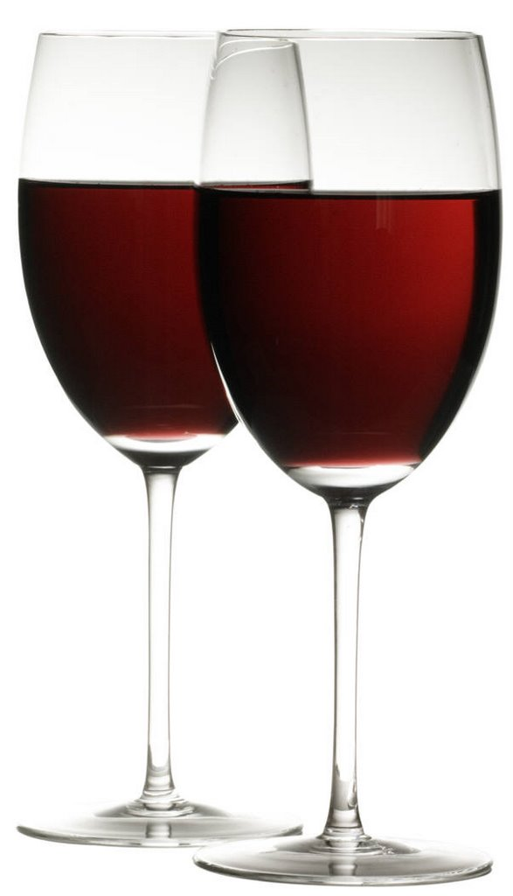
Another Example of “Price = Quality”
Consumers told one wine costs $5 and the other costs $45, when in fact they are the same wine
Pleasure sensors in the brain more active when drinking the seemingly more expensive wine
Source: Shiv, (2008)

Slide 51
What We’ve Learned (So Far)
Sub Optimal Spending
  People do not know what they like (or will like)
  People do not know how much to pay
  People spend too much and borrow too much
Heuristics Used in Spending Decisions
  Extremeness Aversion
  Price = Quality

Slide 52
You Give What You Get
People tend to spend exactly what they earn – especially students

Slide 53
What We’ve Learned (So Far)
Sub Optimal Spending
  People do not know what they like (or will like)
  People do not know how much to pay
  People spend too much and borrow too much
Heuristics Used in Spending Decisions
  Extremeness Aversion
  Price = Quality
  Spending exactly as much as you earn

Slide 54
How to Help People Make
Better Financial Decisions

Slide 55
Can We Help People…
Determine their preferences,
Assign values to their preferences, and
Live within their means?

Slide 56
What We’ve Learned
Sub Optimal Spending
  People do not know what they like (or will like)
  People do not know how much to pay
  People spend too much and borrow too much
Heuristics Used in Spending Decisions
  Extremeness Aversion
  Price = Quality
  Spend exactly as much as you earn
Helping People Make Better Decisions

