Slide 1
Psychology and Personal Finance
Heuristics and Biases

Slide 2
Overview
Heuristics
  What “shortcuts” are we using?
Biases
  When are we predictably wrong?
Other Behavioral Principles
  Why do we behave the way we do?
Assignment 1 Overview

Slide 3
Remember This Exercise?
1000
10
1000
20
1000
30
1000
40
Is it 5000….
…or 4100?
Sometimes, heuristics can lead to the wrong answer!

Slide 4
Heuristics and Biases
Heuristics = “Quick Rules of Thumb”
  Optimal decision NOT guaranteed
Biases = “Applying Heuristics Inappropriately”
  Can negatively influence decision making process

Slide 5
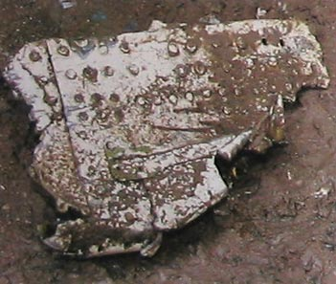
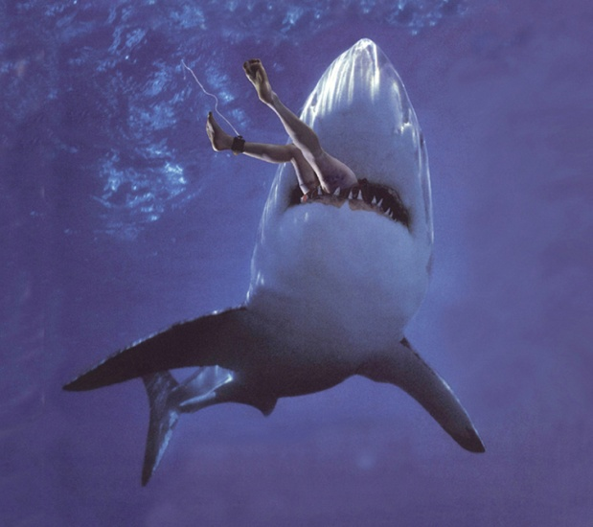
Question:
Which is the more likely cause of death?
Falling Plane Part Shark Attack
Death by falling plane parts is 30x MORE likely
Source: http://www.learner.org/discoveringpsychology/11/e11expand.html
Notes:
Remove bottom statistic from class slides

Slide 6

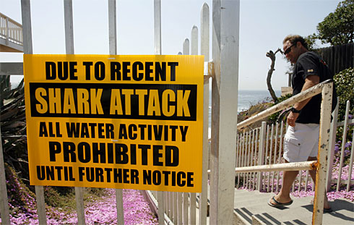
Availability Heuristic
Readily available events in memory affect the judgment of frequency
Notes:
A Google search for shark attacks provided hundreds of resources…falling plane parts search returned 9/11 facts and this retrievability bias example only

Slide 7
What We’ve Learned (So Far)
Heuristics
  Availability: readily available events in memory affect the judgment of frequency

Slide 8
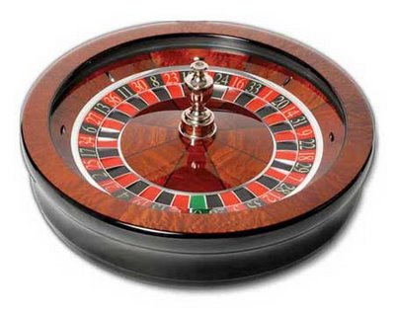
Roulette Anyone?
Roulette is a casino game where a wheel and a ball are spun in opposite directions and eventually, the ball falls into a space. Bets can be placed on whether the ball will fall into a red, black, or green space.
There are 18 red spaces,
18 black, and 1 green

Slide 9
Question:
You’re in Vegas and walk up to roulette tables with the 5 previous spins posted as:
Which table would you feel more comfortable placing a bet on “black”?
Table 1 | Table 2
2 | 9
27 | 36
31 | 7
26 | 5
12 | 9

Slide 10
Representativeness Heuristic
Representativeness Heuristic
  Belief that even small samples should be representative of the population
  People also think that the recent past is indicative of the future
The Gambler’s Fallacy says:
  5 “reds” in a row in a fair game…black is due!
10

Slide 11
What We’ve Learned (So Far)
Heuristics
  Availability
  Representativeness
    Gambler’s Fallacy: 5 “reds” in a row in a fair game…black is due!
11

Slide 12
Question: What Will Google’s Price Be In The Future?
Source: www.morningstar.com

Slide 13
What We’ve Learned (So Far)
Heuristics
  Availability
  Representativeness
    Gambler’s Fallacy
    Excessive Extrapolation: 3 years of increases…it’s bound to increase again!
13

Slide 14
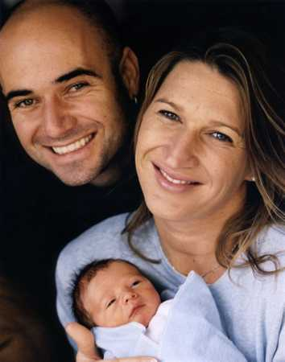
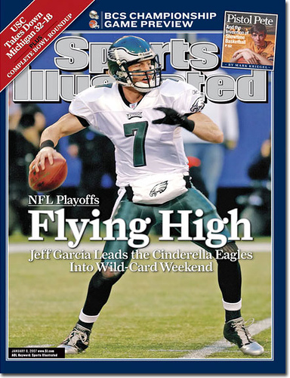
Do You Believe…
This is a Future Tennis Prodigy?
There is a
SI Cover “Jinx”?

Slide 15
Question:
What would you predict these 3 students’ college GPAs to be based on their high school GPAs?
Student
A
B
C
High School GPA
3.80
3.00
2.20
Predicted College GPA
3.46
2.77
2.03
Actual College GPA
3.30
2.93
2.70
Source: Shefrin (2000)

Slide 16
Regression Toward the Mean
Extreme scores or performances measured at any one point in time will probably be less extreme the next time they are measured

Slide 17
What We’ve Learned (So Far)
Heuristics
  Availability
  Representativeness
    Gambler’s Fallacy
    Excessive Extrapolation
    Regression Toward the Mean: extreme observations will most likely revert to the mean
17

Slide 18

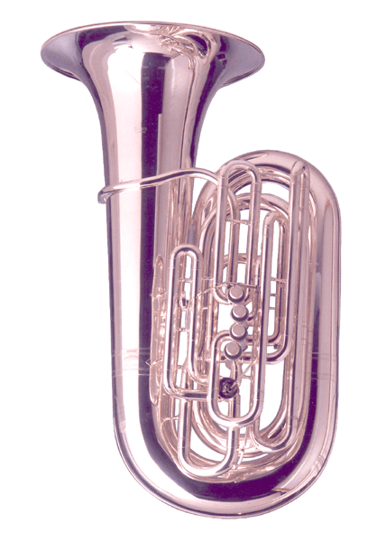
Question:
(1) Write down the last 4 digits of your SSN
(2) Do you think that a Gronitz PCM-5 CC Tuba costs more or less than this number?
(3) What is your best estimate of the cost of a Gronitz PCM-5 CC Tuba?

Slide 19
Anchoring
The tuba costs ~$12,000 according to www.tubaexchange.com
Any arbitrary number can influence your guess by “anchoring” you to that number

Slide 20
What We’ve Learned (So Far)
Heuristics
  Availability
  Representativeness
  Anchoring: any arbitrary number can influence your guess by “anchoring” you to that number
20

Slide 21
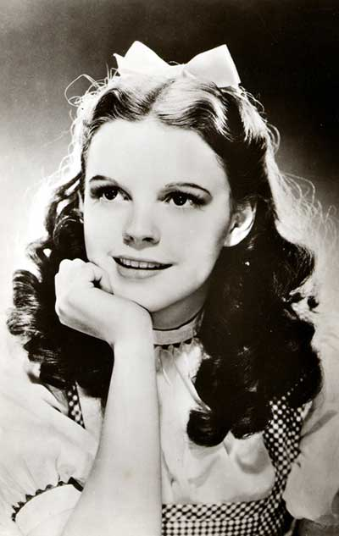
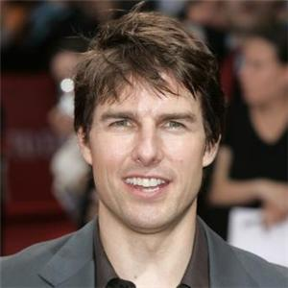
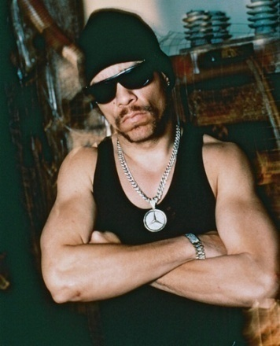
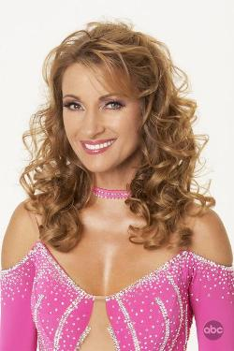
Affect Heuristic
  Why do entertainers change their names?
  Less attractive names are judged to be of lower quality
Judy Garland
or
Frances Gumm?
Tom Cruise
or
Tom Mapother?
Ice - T
or
Tracy Marrow?
Jane Seymour
or
Joyce Frankenburg?
Source: Slovic, et. al (2002)

Slide 22

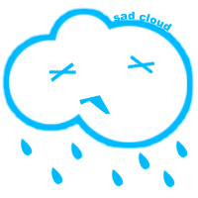
Affect Heuristic
An emotional evaluation that occurs before conscious reasoning
“The stock market is more likely to go up on sunny than on cloudy days…”
Source: http://heuristics.behaviouralfinance.net/affect/

Slide 23
What We’ve Learned (So Far)
Heuristics
  Availability
  Representativeness
  Anchoring
  Affect: an emotional evaluation that occurs before conscious reasoning
23

Slide 24
Question:
What grade do you expect to get in this class?

Slide 25
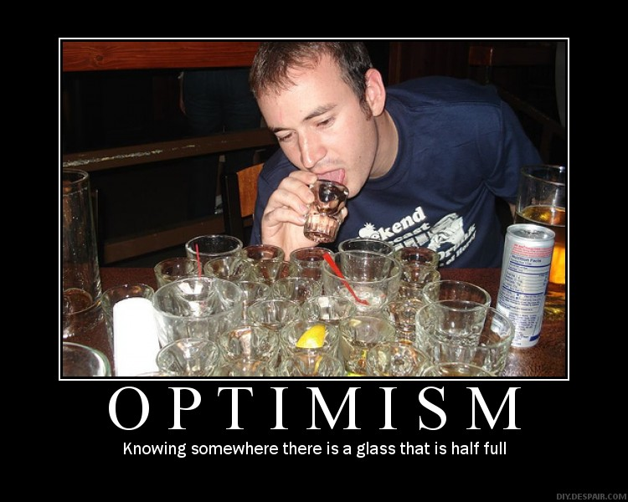
Optimism

Slide 26
What We’ve Learned (So Far)
Heuristics
  Availability
  Representativeness
  Anchoring
  Affect
Biases
  Optimism
26

Slide 27


Slide 28
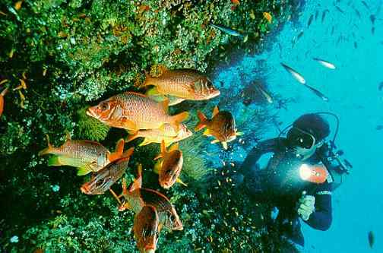

Slide 29
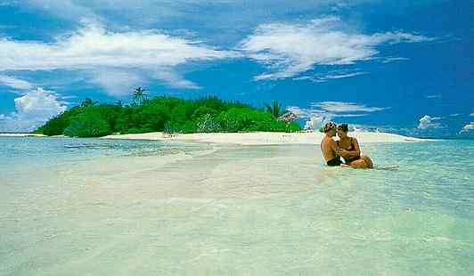

Slide 30

Question:
What’s your range with 90% confidence on what it would cost to have your own private island in the Maldives for a day?

Slide 31
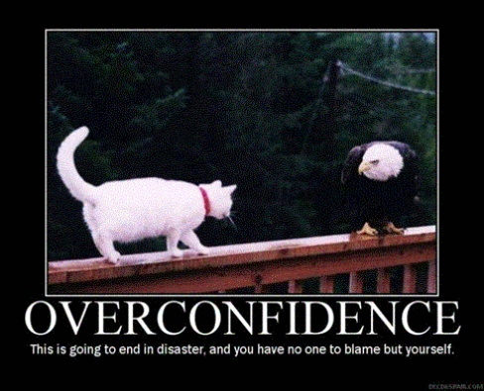
Overconfidence

Slide 32
What We’ve Learned (So Far)
Heuristics
  Availability
  Representativeness
  Anchoring
  Affect
Biases
  Optimism
  Overconfidence
32

Slide 33
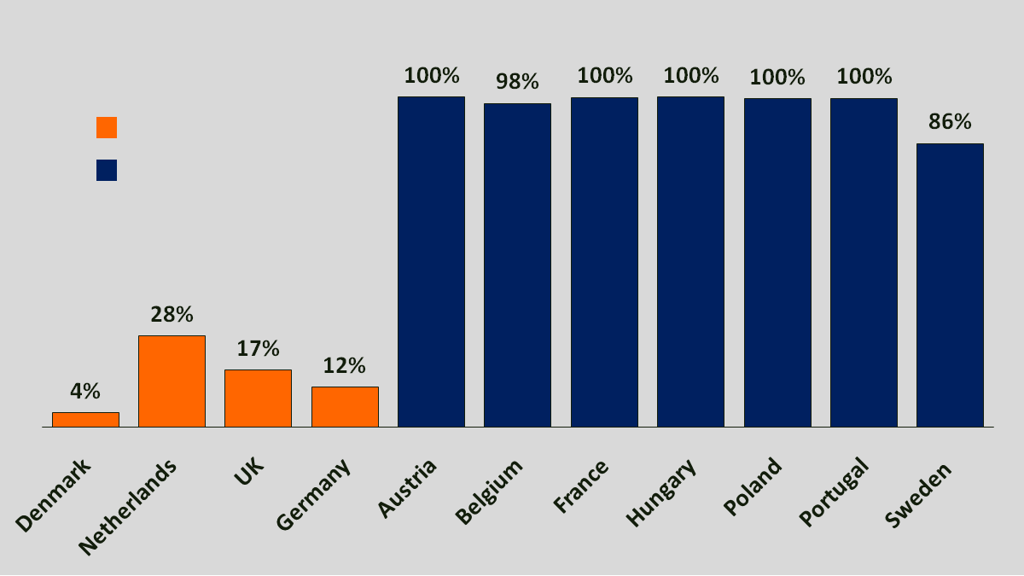
Organ Donation Consent Rates
Opt-In
Opt-Out
Source: Johnson, et. al (2003)
33

Slide 34
What We’ve Learned (So Far)
Heuristics
  Availability
  Representativeness
  Anchoring
  Affect
Biases
  Optimism
  Overconfidence
Other Principles
  Inertia
34

Slide 35
Blackjack Rules
The dealer hands you two cards, facing up. The dealer also receives two cards, but you can only see one. To win, your cards must total more than the dealer’s.
You can request more cards to increase your total, but if your total exceeds 21, you lose immediately.

Slide 36
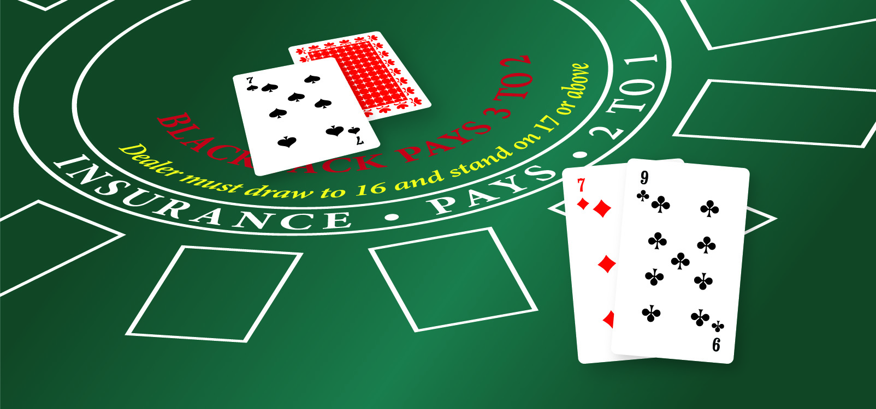
Let’s Play A Game…
Hit or Stand?

Slide 37
Blackjack
Experts say you should take another card (hit)
Most players do not take a card (stand)
Why?

Slide 38
Regret Aversion
Taking action and losing feels worse than “doing nothing” and losing
Although the outcome is the same, regret plays a larger role post-action

Slide 39
What We’ve Learned (So Far)
Heuristics
  Availability
  Representativeness
  Anchoring
  Affect
Biases
  Optimism
  Overconfidence
Other Principles
  Inertia
  Regret Aversion
39

Slide 40
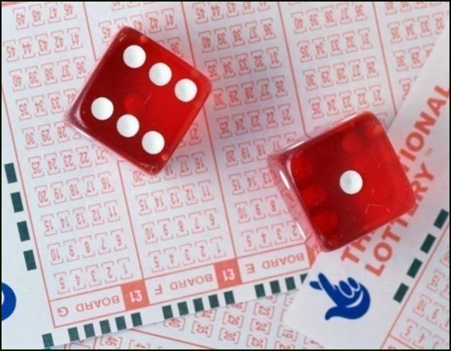
Illusion of Control
Craps players throw harder when they want higher numbers and softer for lower numbers
People choose their own lottery numbers, thinking they can pick the winners
Source: Henslin, (1967)

Slide 41
What We’ve Learned (So Far)
Heuristics
  Availability
  Representativeness
  Anchoring
  Affect
Biases
  Optimism
  Overconfidence
Other Principles
  Inertia
  Regret Aversion
  Illusion of Control
41

Slide 42
Question:
Do you think that the price of crude oil was higher in 1981 or 2007?

Slide 43
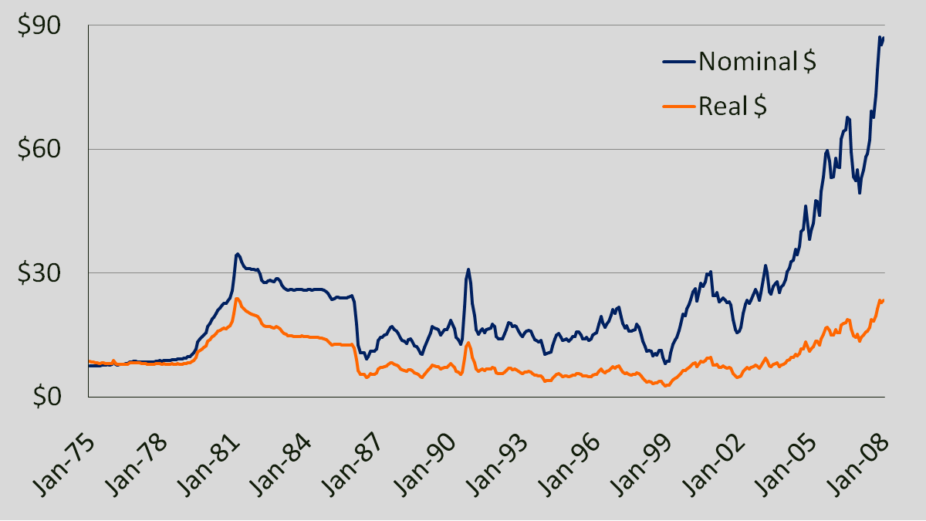
Money Illusion – Price of Crude Oil
Source: http://en.wikipedia.org/wiki/Image:Oil_Prices_1861_2007.svg

Slide 44
What We’ve Learned (So Far)
Heuristics
  Availability
  Representativeness
  Anchoring
  Affect
Biases
  Optimism
  Overconfidence
Other Principles
  Inertia
  Regret Aversion
  Illusion of Control
  Money Illusion
44

Slide 45
Driving in Bolivia
The Stremnaya Road is extremely beautiful with gorgeous mountains, cliffs and greenery. While the road offers dramatic scenery, it is considered by some the most dangerous road in the world. The combination of extremely narrow roads and tall cliffs could easily result in a deadly accident, and an average of two vehicles per month fall from the road. The danger of the road ironically though has made it a popular tourist destination starting in the 1990s. Mountain biker enthusiasts, in particular, have made it a favorite destination for downhill biking.

Slide 46
Question:
Would you be interested in taking an all expenses paid trip to the Stremnaya Road?
  __ Yes
  __ No
  __ I am not sure

Slide 47
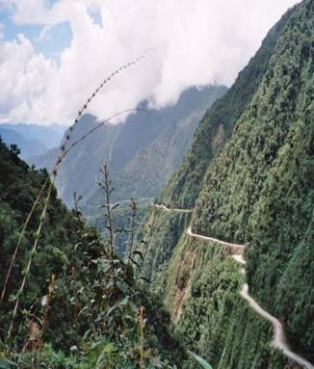

Slide 48
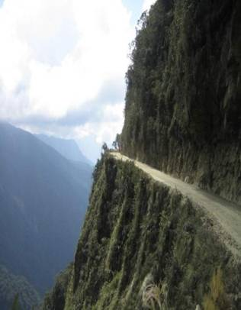

Slide 49
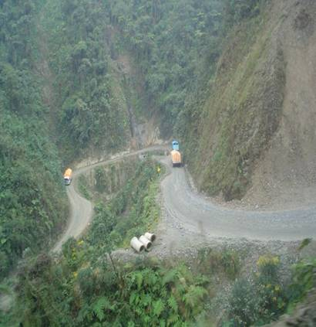

Slide 50
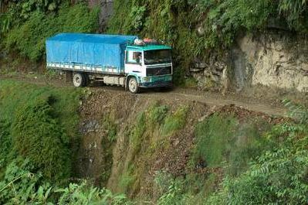

Slide 51
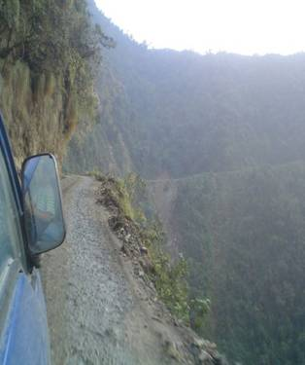

Slide 52
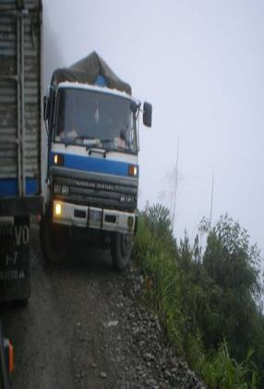

Slide 53
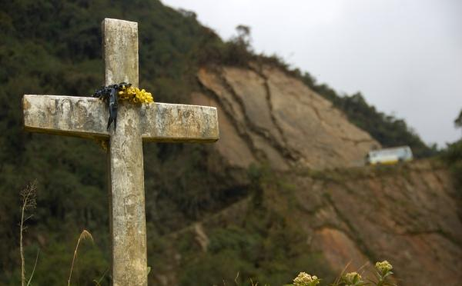

Slide 54
Question:
54
Would you be interested in taking an all expenses paid trip to the Stremnaya Road?
  __ Yes
  __ No
  __ I am not sure

Slide 55
Intuitive vs. Deliberative Self
Cognitive / Deliberative
Relatively slow
Demanding of cognitive capacity
Controlled
Analytic
Rule-based
 | Intuitive / Affective
 | Relatively fast
 | Undemanding of cognitive capacity
 | Automatic
 | Holistic
 | Associative
Sources: Stanovich and West (2002)

Slide 56
Consequences
Affective processing can result in...
  Paying more to save a panda bear
  Taking less risk in a variety of domains (from smoking to choosing travel destinations)
  Saving more for retirement
Sources: Hsee and Rottenstreich (2004), Hammond et al. (2004, 2006)

Slide 57
What We’ve Learned
Heuristics
  Availability
  Representativeness
  Anchoring
  Affect
Biases
  Optimism
  Overconfidence
Other Principles
  Inertia
  Regret Aversion
  Illusion of Control
  Money Illusion
  Intuitive vs. deliberative self
57

Slide 58
Additional Concepts
Mental Accounting
Ambiguity Aversion
Familiarity Bias
Choice Overload
Elderly Innumeracy
Ease of Evaluation

