Slide 1
Happy Appy
Opportunity Costs and Happiness
Stephen Lynch, Ashley Zimmer, Matthew McCloskey
Notes:
This is Happy Appy, an online business that personalizes individual opportunity costs to help people optimize their happiness.

Slide 2
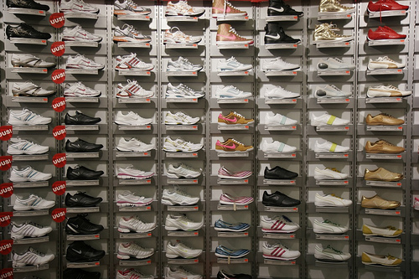
The Big Idea
Happy Appy
We live in a world where there are dizzying amount of options and choices. Individuals do not truly understand what makes them happy. The behavior is manifested in sup-optimal time allocation and spending decisions.
I don’t know what I want ….
Can someone help me with my spending decisions?
Notes:
At its core, Economics is a measurement of happiness. And, as we learned last week, people don’t really know what makes them happy. As a result, we spend our time and money on things that may make us happy, but we’re not maximizing our happiness quotient. The fact that we have so many choices doesn’t help matters.

Slide 3
The Big Idea
Happy Appy
An online service that seeks to optimize spending and saving decisions as they relate to an individual’s happiness. By understanding the fundamentals of clients’ happiness, HappyAppy.com hopes to alter customers’ spending decisions by presenting opportunity costs of their financial decisions.
www.HappyAppy.com
Helping you optimize spending and saving decisions to maximize happiness.
Notes:
Thus the idea for Happy Appy. Broadly stated, Happy Appy is an online service that seeks to optimize individual’s spending and saving decisions as they relate to an individual’s happiness. By understanding what makes each person happy, which we will do through a comprehensive online test, happy appy can create a “happiness profile” for each user. Based on the happiness profile, users will be presented with opportunity costs of each potential purchase. We’ll explain all this is greater detail.

Slide 4
Step 1: How it works: The Happy Test
Happy Appy
“I am happiest when…”
The Happy Test will diagnose the items and events that make you the happiest.
The Happy Test: How it works
Comprehensive online test
Considers material items, events and no-cost activities
Individual Happy Profile to maximize happiness
Notes:
So here’s how it works. In the first step, users will go to happyappy.com and complete a free online test, similar to a myers-briggs test or the career finder test that we all took before school. The test will ask users a series of hypothetical questions regarding their likes, dislikes, lifestyle, budget as well as savings goals. Based on the responses, the test will generate a “happy profile” for each user. Within each happy profile, there will be categories that will be assigned

Slide 5
Step 2: Presenting Alternative Options
Happy Appy
Happy Appy
Simple to use program that shows consumers alternative choices that will bring about the most happiness.
Smart Phone App
Access your profile
Scan item with barcode scanning app and input product info into app.
Program analyzes “fits” in happiness profile.
Program offers alternatives for same price but higher happiness or how the money could be used for long-term savings goals.
Notes:
iPhone App: After users complete the happy test, they will be encouraged to download the Happy App to their cell phone (also free of charge)
The Happy App will be able to access individual users happy profiles and savings goals.
Before making a purchase, users would scan the item with iPhone bar code scanner to input the item’s information into the app.
The program would analyze where the item fits into the happiness profile and offer alternatives for the same price that would theoretically provide a higher level of happiness for that individual user. There would be an option to “find the product” on the app that would take user to vendors’ websites where they could purchase the product.
The app would also provide figures on how saving the money would contribute to long-term saving goals.

Slide 6
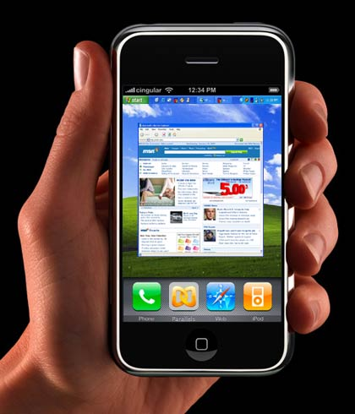
Step 3: Alternative Purchase & Savings Example
Happy Appy
Consumer will scan a product that they are considering purchasing and press the number of smiley faces to indicate how happy the product would make them.
I Want It Now!!!
Potential Purchase |  | Shoes | $200

Slide 7
Step 4: Alternative Purchase & Savings Example
Happy Appy
Happy Appy will then show how much money that purchase would contribute to the consumer’s retirement account and other items with their happiness factors.
What about this…
Potential Purchase |  | Shoes | $200
Saved by Retirement |  |  | $7,194
Alternatives | Cost | Happy Factor | Happy Rank
Purse | $458 | 5 | 1.1
Shoes | $200 | 6 | 3.0
Dress | $100 | 8 | 8.0
Movie | $30 | 1 | 3.3

Slide 8
Step 5: Track Progress
Happy Appy
Part of www.HappyAppy.com/
would be a progress tracker that demonstrates to users how the program has changed their spending decisions for the better (hopefully).
Monthly summaries of spending habits.
Idea: demonstrate progress (both spending decisions and savings goals) will encourage continued use and reinforce improved spending habits

Slide 9
Behavioral Concepts Addressed
Happy Appy
This product is designed to help people stop making bad financial spending decisions that ultimately do not provide more happiness.
Bias | Solution
People do not know what makes them happy. | The quiz helps people to identify the items/activities/investments/savings that bring them more happiness.
Affect Heuristics | Avoid impulse buying and recognize opportunity costs that will lead to more personalized happiness. Prevents an emotional evaluation of a purchase before conscious reason.
Opportunity Costs / Sub-Optimal Spending | Helps to determine personalized preferences and assign a value to each of the preferences.
Intuitive v. Deliberate Self | Helps to try to get people to avoid impulse purchases and try to tap into deliberate purchases.
Mental Accounting | Avoid using easy shortcuts to determine the cost of something and to realize the opportunity costs.
Inertia (savings) | Providing the consumer with knowledge of how the money can be used differently with different types of investments, etc.

Slide 10
Projected Revenue
Happy Appy
Forecasted Revenue will come from two sources: 1) every time a consumer chooses an advertised product that brings them more happiness than the original product and 2) yearly fees from consumer product advertisers.
Projected Transaction Revenue
Year | No. of Users | Avg. Purchase | No. of Purchases Per Year | 1% Service Charge | Total Revenue
2011E | 10,000 | $ 75 | 10 | 1% | $ 75,000
2012E | 40,000 | $ 100 | 15 | 1% | $ 600,000
2013E | 75,000 | $ 110 | 25 | 1% | $ 2,062,500
Projected Advertising Revenue
Year | No. of Advertisers |  | Yearly Fee |  | Total Revenue
2011E | 50 |  | $ 5,000 |  | $ 250,000
2012E | 75 |  | $ 5,000 |  | $ 375,000
2013E | 150 |  | $ 5,000 |  | $ 750,000

Slide 11
Happy Appy
Questions?

